Slide 1
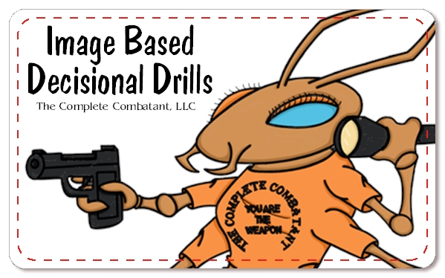

Slide 3
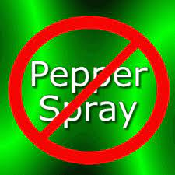
Sterile Training Environment
We have a procedure for this. We have 3 (three) confirmations of safety. Please follow our “step by step” directions.
Here is what to expect:
1st : We will be removing all non-lethal, less than lethal and lethal weapons from our body and place in a secure area.
2nd and 3rd: We will each receive 2 pat downs
After the 2 pat downs, you will return to your seat
DO NOT GO IN THE SECURED AREA WITHOUT ASKING BRIAN OR THE HOST. IF YOU BREAK THIS RULE, YOU WILL BE ASKED TO LEAVE.
We know this is strict but safety first. There can be NO mistakes.

Slide 4
IBDD DEFINITION OF SUCCESS:
To quickly make ONE good FIRST decision based on visual stimuli & instantly act on it.
Be confident, decisive, efficient, & explosive.
Let’s jump right in!!!

Slide 5
you are your own first responder. these NEXT drills are to measure your ability to see, believe, make one good first decision & then act on it. WE HAVE MANY LEVELS OF EXPERIENCE IN THIS ROOM RIGHT NOW SO the decisions you make right NOW are according to your current individual skill level. Here are Instructions = Read and/or listen to the directions carefully.
I will not help you or answer any questions during these drills but I may ask them.

Slide 6
The images up next will be considered about 2 - 4 yards from you. The scenario is happening to you, in front of you, or beside you. They are strangers. You are alone. Just like in real lifE, Visual stimuli is the “go signal” = when the image appears on the screen the countdown begins.

Slide 7
We will be working with the MAIN 8 OPTION CARDS. Please get them out of the bag and lay them FACING UP in front of you (Does the 9th option apply to you?). As we go over each IBDD option, please familiarize yourself with that specific OPTION card. you will have 10 seconds to look at that image, make ONE good first decision, and HOLD UP THE ONE BEST OPTION CARD. A timer will be used. when the 10 seconds are up…Beep!

Slide 8
FOCUS ON ONE GOOD FIRST DECISION
Please set the timer for 10 seconds.

Slide 10
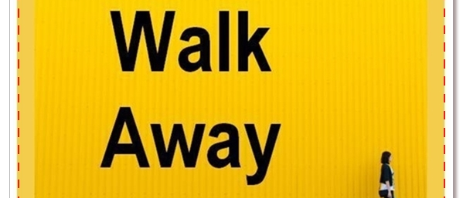
1st = if I had an option card, I WOULD BE HOLDING UP THE “walk away” CARD
Let’s focus on one good first decision.

Slide 11
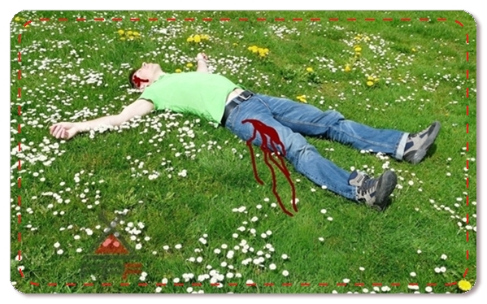

Slide 12
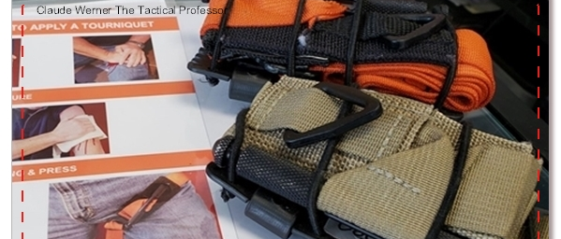
Did you HOLD UP…. 1st = tourniquet?
Let’s focus on one good first decision.

Slide 13
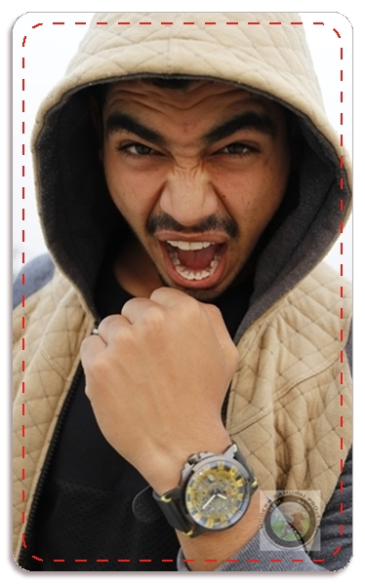

Slide 14
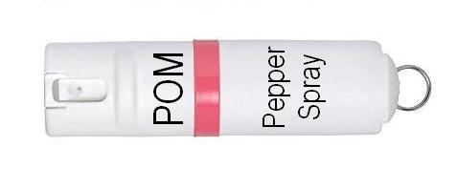
Did you HOLD UP…. 1st = oc/pepper spray?
Let’s focus on one good first decision.

Slide 15
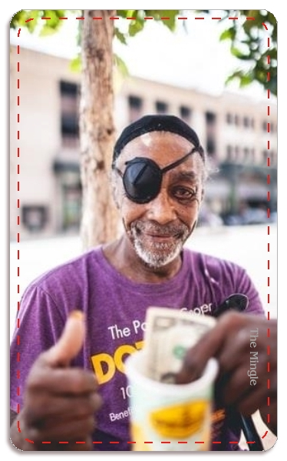

Slide 16
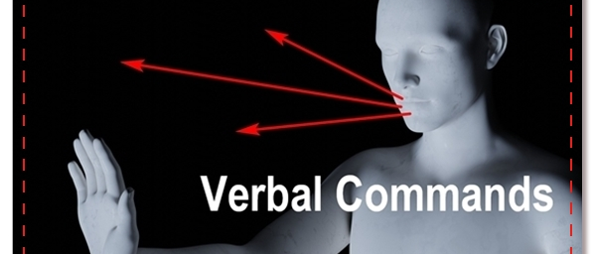
Did you HOLD UP…. 1st = Verbal commands and/or walk away?
Let’s focus on one good first decision.

Slide 17
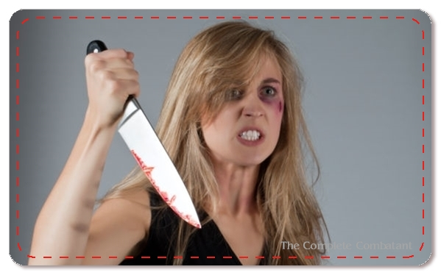

Slide 18
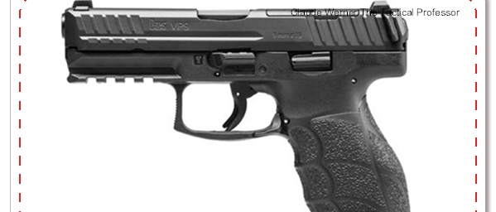
Did you HOLD UP…. 1st = lethal force?
Let’s focus on one good first decision.

Slide 19
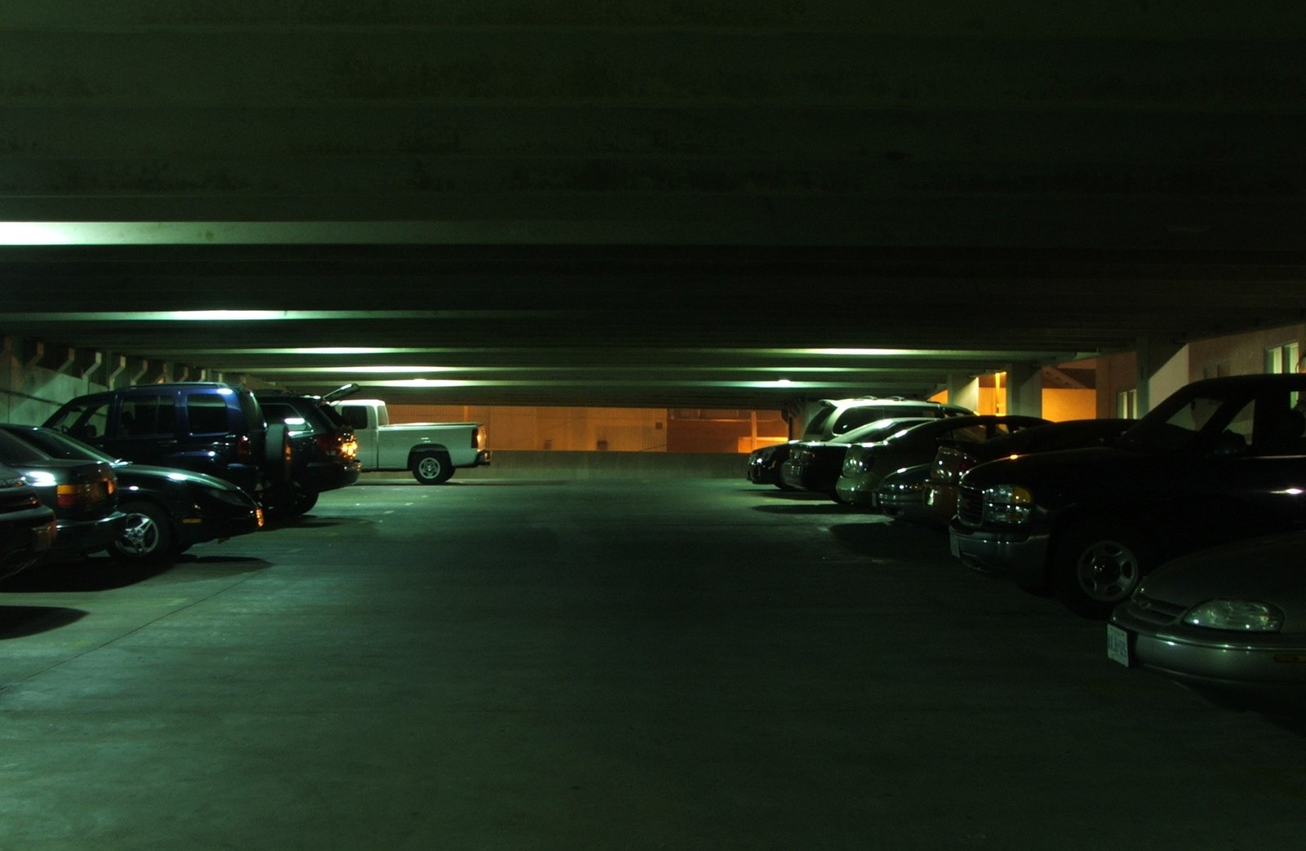

Slide 20
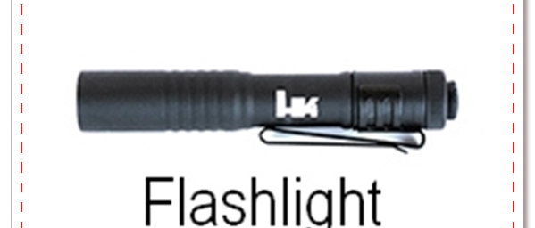
Did you HOLD UP…. 1st = flashlight?
Let’s focus on one good first decision.

Slide 21
Did we get your gears turning? Did you make a GOOD first decision? Did yours match mine?

Slide 22
Thank you, BRIAN HILL, SHELLEY HILL, Gary Klein, Force Science Institute, Steve Tarani, Psychology Today, Claude Werner, Gavin de Becker, William Aprill, Chuck Haggard, Craig Douglas, John Murphy, John Correia, Greg Ellifritz, Andrew Branca, Massad Ayoob, Marty Hayes and SOOOOO many more…
Recognition-prime decisions: A model of how people make quick effective decisions when faced with complex situations. In this model, the decision maker is assumed to generate a possible course of action, compare it to the constraints imposed by the situation, and select the first course of action that is not rejected.
WE ARE LOOKING FOR ONE GOOD
FIRST DECISION.

Slide 23
THE IMPORTANCE OF DECISIONAL TRAINING = WHY WE DID IT?
Decisions are more important than techniques.
People carry a lot of gear but gear does not solve the problem…YOU DO!
We think there is a GAP in our training. We need to have “well rounded” skills for self protection and NOT just train with the gun.
MINDSET, avoidance, deselection and verbal commands are used MORE than any other forms of self defense.
There are very few dry or live practice exercises that focus on making lethal, less than lethal and non lethal decisional quickly.
Tool cycling and cognitive stacking of decisions MUST be practiced often.

Slide 24
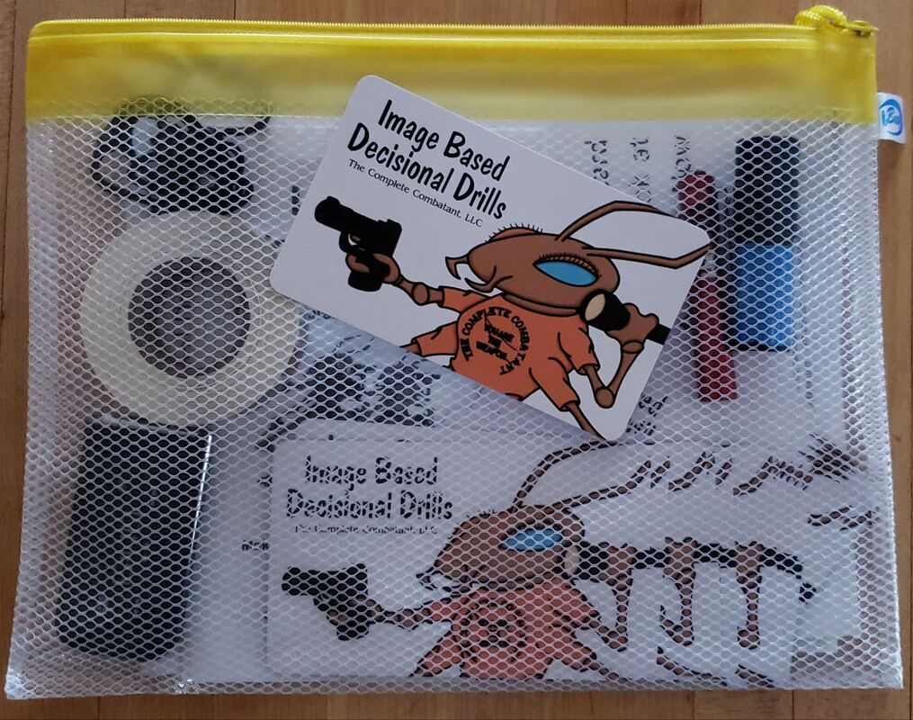
HOW DOES PRACTICING WITH IBDD HELP?
Evaluate the strengths and weaknesses of your strategies/decisions in the content of the scenario.
Visual cueing, pre-need decision making, tool cycling, and distance management .
Creating “files” in your brain that you recognize to thaw the freeze.

Slide 25
Let’s talk about PROXEMICS “in a nutshell”
Edward T. Hall is the cultural anthropologist who coined the term ion 1963. PROXEMICS is the science of HOW we USE the space around us and HOW we VIEW it in terms of interaction with other people.
INTIMATE SPACE = 18 inches
PERSONAL SPACE = 18 inches to 4 feet
SOCIAL SPACE = 4 feet to 12 feet
PUBLIC SPACE = 12 feet and beyond. Public space is the space the WE PERCEIVE that people have “the right to be” unless for some reason “they don’t”. Our goal is to make ALL decisions no closer than 12 feet so “danger” can not enter our social, personal or intimate space.
12 FEET = DISTANCE = TIME = MORE DECISIONS.

Slide 26
4 Yards = 12 Feet. Visual Person?
Visualize 4 shopping carts:
The are roughly 3 yards each
Visualize a Honda Civic.
They are just over 4 yards each

Slide 27
ALTERED PERCEPTIONS DURING OR AFTER AN IBDD SCENARIO OR REAL-LIFE INCIDENT
EMBELLISHMENT: An untrue decorative detail or feature added to something to make it more attractive.
CREATING A NARRITIVE OR STORY TELLING: Mind replays: You change the truths, you are the hero, over explain actions.
AUDITORY EXCLUSION: Ignoring the BEEP of the timer or even my voice.
COLOR TRANSFERENCE: Incorrect color and placement due to a dominate color.
STALLING: To delay or prevent from doing something for a period of time.
VISUAL PROBLEMS: Can’t “believe” what you are seeing. “What am I looking at? I don’t get it”.
TACHYPSYCHIA: Will lose all sense of time.
Time dilatation: Slowing down or speeding up

Slide 28
IBDD “OPTIONS GET MORE TRAINING! THIS image based DECISIONAL DRILLS “MINI CLASS” IS A BENEFICIAL learning system TO HELP YOU make ONE good FIRST decision quickly. ”
Walk Away
Run
Flashlight
Verbal Commands
OC/Pepper Spray
911
Apply Tourniquet
Shoot: Failure To Neutralize
Hidden Option = Force on Force/Empty Hand Skills?

Slide 29
IBDD Options
Gait
CONFIDENCE: Gait
Aware
Be cautious, aware of your surroundings, and changes in the environment.
ALWAYS! ALWAYS! ALWAYS! Watch their hands.
Vision
IF POSSIBLE, keep the nuisance/event in your peripheral vision without turning your back to them/it.
Watch
Walk Away
Please articulate the direction, any obstacles, plan, etc.

Slide 30
IBDD Options
4 Yards
Remember, every image (unless obvious) is at roughly 4 yards. Do you have time, AND THE SPACE, to turn and LOOK and then RUN before they reach YOU?
Distance
Shoes
Footwear?
CAN YOU
CAN you physically run?
You may have to consider making a bit of DISTANCE with other options available and then running. DISTANCE EQUALS TIME.
RUN!
Call 911
Verbal Commands
DO NOT ACTUALLY RUN! Please articulate the direction, any obstacles, plan, etc.
OC/Pepper Spray
Simple Steps to Apply a Tourniquet
Shoot = Failure to Neutralize

Slide 31
IBDD Options
MORE
Gather more information.
ID
Identify “WHO IS THERE”?
Deselection tool. HOW?
Not me!
Flashlight
Call 911
Turn the flashlight ON and bring it to your eyeline.

Slide 32
IBDD Options
ALWAYS
First
Give your LOCATION first.
What to Say
We recommend you follow with “I am the victim, explanation, attacker’s location & description and then ask for medical attention (if pertinent).”
Essentials
We recommend saying “as little as possible” and to only offer the essential information.
911 Call
Verbal Commands
Pick up the PROP PHONE, push 911 and then send.
Hold the phone to your ear OR articular that you are using the “speaker”.

Slide 33
IBDD Options
ASK
ASK: No, I am sorry I don’t (William Aprill).
Ignored
X 1
Ignored? What does that mean?
TELL
TELL: GET AWAY FROM ME!
Ignored x 2
Ignored? MAKE….coming up.
Verbal
Commands
Call 91
Verbal commands can be the hardest to execute so you MUST practice your delivery, your body language, and your commands.
Consider “frames” or “fence

Slide 34
IBDD Options
OC/Pepper Spray
“In a nutshell”
Verbal commands. Thumb on button, extend arm, press while spraying across eyes (ear to ear). Accurate aim is critical.
Get ready sooner
PRE-deploy/have in hand if possible. We recommend thumb resting on TOP of cannister. WHY?
MAKE!
Ask. Tell. MAKE: DON’T MOVE!!!!
Get Away
Run away. Get to safe place. Call 911
Help
police
Good description of assailant?

Slide 35
IBDD Options
Tourniquet
Please review the “Simple Steps to Appy a Tourniquet” that are placed on each table.
In your scenario, if you decide to apply a tourniquet then VERBALIZE your actions from start to finish.
Retrieving YOUR tourniquet from where?
Verbal?
Placement?
How tight?
Calling 911? DO IT
Tourniquet
IBDD teaches “Simple Steps to Apply a Tourniquet”. High in armpit. High in crotchpit. Tighten until bleeding stops.
MORE!
SEEK MORE MEDICAL TRAINING!
Words Matter
Be confident, speak to the injured person with kindness and reassure them they will be ok, etc.
Practice
GOAL: 30 seconds to apply the tourniquet.

Slide 36
IBDD Options
Failure to Neutralize
We use a SIRT Training Pistol in our IBDD classes. The immediate feedback is beneficial.
Please make note that during IBDD “The Class”, the 7 other options are available to you EVEN IF YOU DON’T CARRY THEM but the use of a firearm is NOT.
We WANT you to experience tool cycling with non-lethal and less than lethal options.
See IBDD RULES #1 and #2
Lethal Decision
2 shots to the body and 1 shot to the head.
Why F2N
If 2 shots to the body did not stop the person then 1 shot to the head will be an instant stop.
IBDD Rule #1
If you do not carry a firearm every day, then the decision to use lethal force is not an option.
IBDD Rule #2
If your scenario takes place in your home, and your have a home defense firearm, then you MAY add lethal force as an option.

Slide 37
IBDD Options
FORCE ON FORCE TRAINING
Training in “force on force” consistently
Practices combatives with a non corporative partner
Past extensive history of combative style training
Integrated weapons training with modern weapons (firearm, knife, club, etc.)
The RARE 9th Option
Do you meet the criteria for the 9th option?
Honor system
Is the 9th option your ONE first GOOD decision?

Slide 38
Remember,
Decisions are more important than techniques.
We may have just added a few more techniques to your “good decision” skill set
so let’s start stacking them.

Slide 39
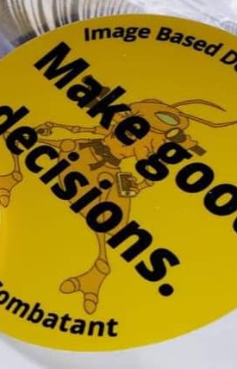
Cognitive skills and knowledge involve the ability to acquire factual information, often the kind of knowledge that can easily be tested like we do through IBDD.
So, cognition should be distinguished from social, emotional, and creative development and ability. It is called a cognitive stack because we have multiple choices and tasks that need to be decided upon.
Cognitive science is a growing field of study that deals with human perception, thinking, and learning.
We are now going to look at the same images but this time we are making MORE than one good decision. The one good FIRST decision stands but now we will cognitively stack SEVERAL GOOD decisions.

Slide 40
8 IBDD option cards
Stay seated. Lay all 8 IBDDIC OPTION Cards on the table in front of you with the “escalation” of force in mind. Does the 9th OPTION apply?
After the image appears on the screen you will have 5 seconds to make decisions and START ACTING ON THEM with the use of your OPTION Cards. DO THE ACTION ON THE CARDS.
Once completed, place your cards in your hand BY THE SEQUENCE of your actions. We will want to see YOUR DECISIONS so be prepared to show your “hand” and explain your course of action.
Example: PUSH the 911 buttons on the PHONE and speak into it as if it were a real phone.
Example: TURN ON the FLASHLIGHT by “clicking on the back” and then hold up to your eyeline to ID….
Example: Verbal Commands? SAY IT out loud.
Example: Tourniquet? EXPLAIN your actions.
Everyone participates in every scenario!
USE THE OPTION CARD(S) as if they were the real deal.

Slide 41
Verbal communication: be confident. keep them calm 911: get help. Location first
TOURNIQUET:
WORK FAST.
STOP THE BLEED.

Slide 42
always look at their hands. run to safe place 911: get help. location first
OC/PEPPER SPRAY WITH LOUD “MAKE” COMMANDS LIKE GET AWAY FROM ME! OR DON’T MOVE!

Slide 43
EVERYONE CLOSE
YOUR EYES!
ACCURATE DESCRIPTION?
Brown eyes
Dark hair
Mustache
Tan vest style hoodie
Large watch
Grey shirt
Medium build
Spanish? Tan skin

Slide 44
WITH RAISED AWARENESS AND LOOKING FOR CHANGES IN YOUR ENVIROMENT. always look at their hands. ASK: NO, I AM SORRY I DON’T TELL: GET AWAY FROM ME MAKE: DON’T MOVE! Do not turn your back
VERBAL “ASK/TELL” COMMANDS AND WALK AWAY

Slide 45
always look at their hands. run to safe place 911: get help. location first. Only essential information.
LETHAL FORCE: NO
TIME FOR OTHER
OPTIONS.
MUST BE STOPPED.

Slide 46
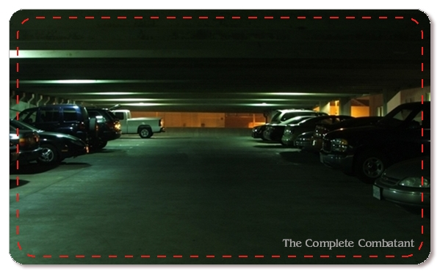
pre-deploy Pepper spray with it in your hand, ready to disperse, with thumb resting on lid. raise your awareness: look around get in car & lock doors: time to go
FLASHLIGHT:
SCAN GARAGE

Slide 47
WE HAVE “CRAWLED”. WE HAVE “WALKED”. It is now time to “run”
Let’s practice a few more images on the screen and then we will move to the PROP table.
Stay seated. Lay all 8 IBDDIC OPTION Cards on the table in front of you with the “escalation” of force in mind. Does the 9th OPTION apply?
After the image appears on the screen you will have 5 seconds to make decisions and START ACTING ON THEM with the use of your OPTION Cards. DO THE ACTION ON THE CARDS.
Once completed, place your cards in your hand BY THE SEQUENCE of your actions. We will want to see YOUR DECISIONS so show your “hand”.
You MAY have to defend your decisions SO be prepared at articulate the WHY you did what you did.

Slide 48
IBDD DEFINITION OF SUCCESS
SAY IT WITH ME…..
To quickly make ONE good FIRST decision based on visual stimuli & instantly act on it.
Be confident, decisive, efficient, & explosive.
Please set the timer for 5 seconds.

Slide 49
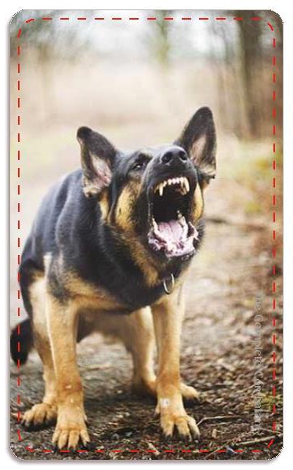
Pepper Spray with alpha verbal commands
Prepare for lethal force
RUN to safe place
911 = LOCATION FIRST

Slide 50
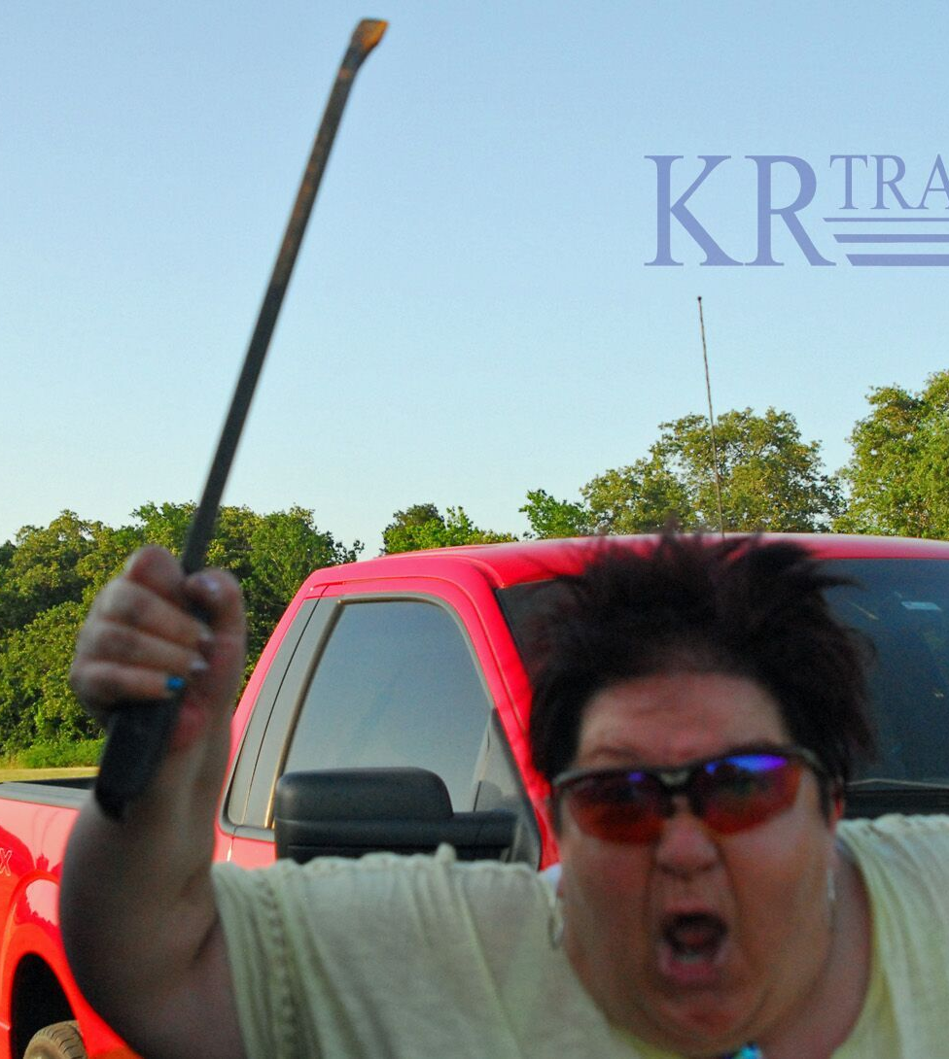
LOOK AT THE HANDS
Lethal Force with verbal commands: GET AWAY FROM ME. DON’T MOVE!
Run to safe place
911 = LOCATION FIRST

Slide 51
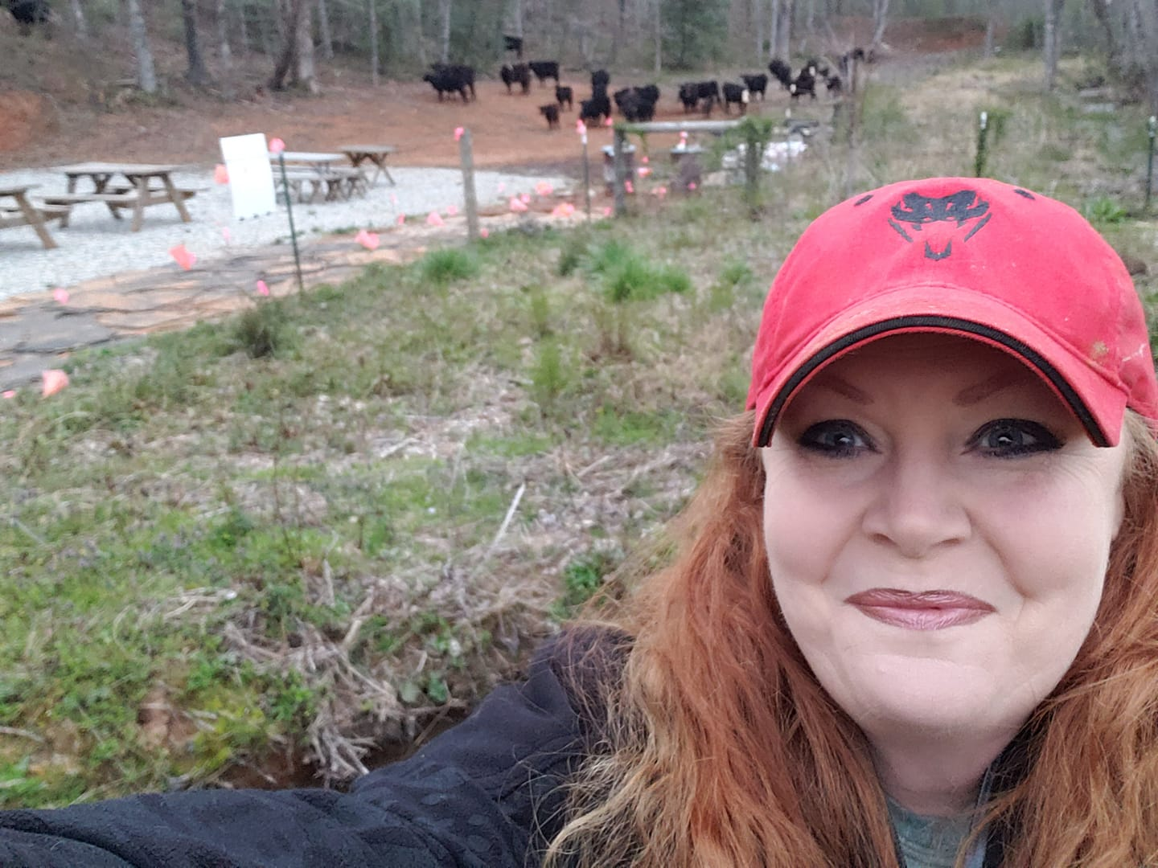

Slide 52
CLOSE YOUR EYES!
ACCURATE DESCRIPTION?
Red hair
Blue eyes
Red hat
Outside
Black cows
Picnic tables
Pink “flags” on fence
White sign on fence
White or grey gravel
Blue jacket

Slide 53
Flashlight to ID
LOOK AT THE HANDS
Pre-deploy Pepper Spray
Be prepared for:
ASK: NO, I AM SORRY I DON’T TELL: GET AWAY FROM ME MAKE: DON’T MOVE!
Walk away or across the street
Raise your awareness

Slide 54
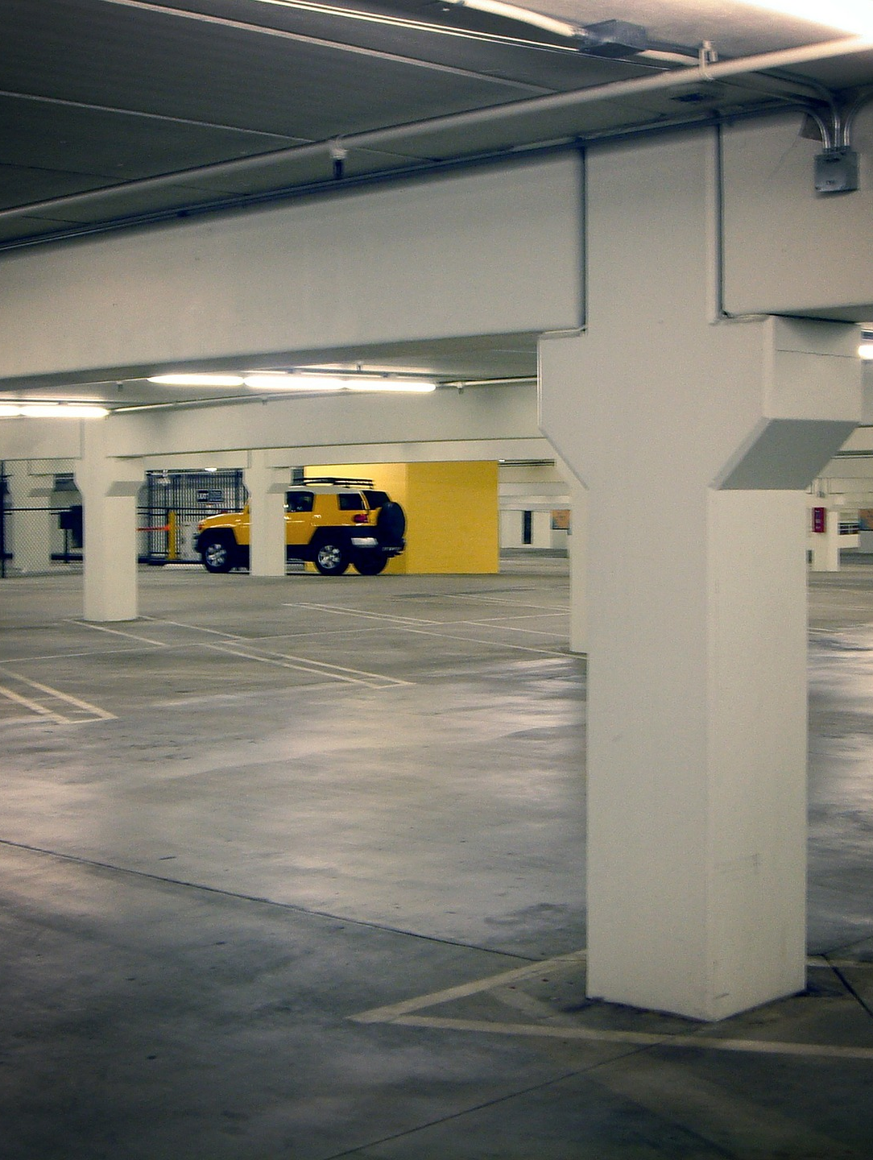
Pre-deploy Pepper Spray
Raise your awareness
Do not walk close to pillars
Get in car and lock immediately

Slide 55
LOOK AT THE HANDS
Pepper Spray with MAKE Verbal Commands. DON’T MOVE!
Run to safe place
911 = LOCATION FIRST

Slide 56
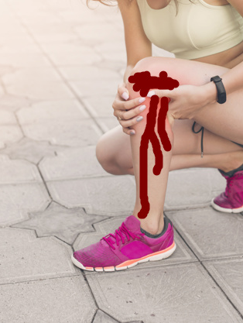
Ask her to sit down
Tourniquet = place HIGH on CROTCH PIT of LEFT leg while giving verbal assurances that you “got this”, she will be just fine and that I am calling 911
911 = LOCATION FIRST
Keep talking to her. Ask questions. Keep her awake and calm

Slide 57
LOOK AT THE HANDS
Walk Away
911 = LOCATION FIRST
Moral Dilemma?

Slide 58
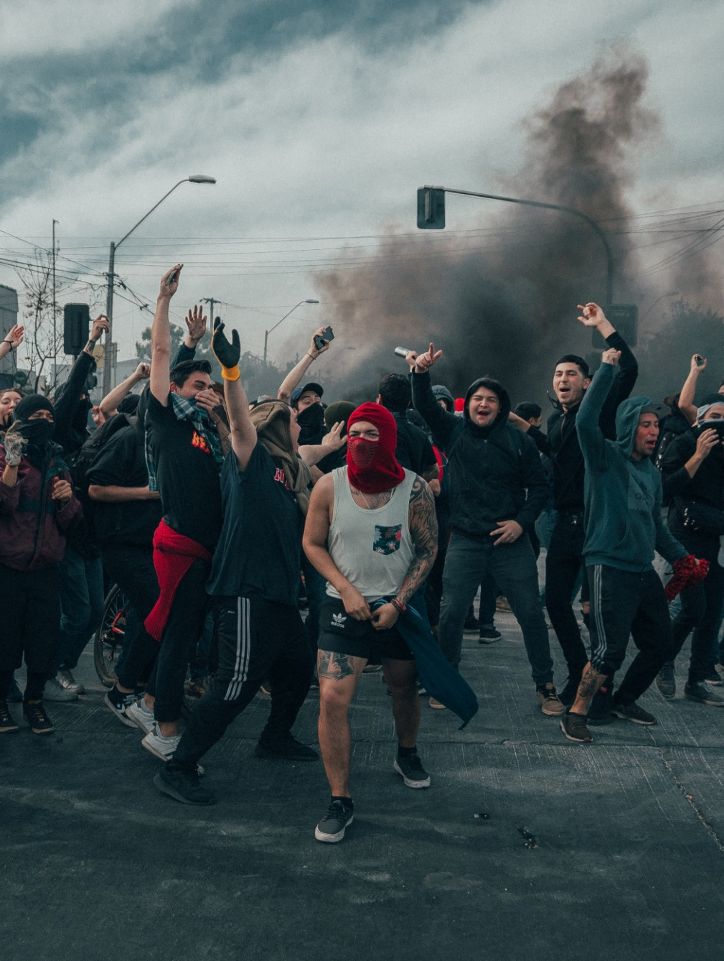
LOOK AT THE CONTEXT
RUN away!
Get to safe place
911 = LOCATION FIRST

Slide 59
IMAGE BASED DECISIONAL DRILLS
KIT, NO KIT and PROP TABLE GUIDELINES
Props on table. SIRT on table or holster.
Target at 4 yards so consider your scenarios at about that range.
Just like in real life, visual stimuli is the “go signal”
After you flip over an Image Card, you have 5 seconds to look at the image, make a decision and start acting on it.
IBDDs are not “telling” drills, they are DOING drills.
That means you ACT ON YOUR DECISIONS from start to finish.
After your drill, place the card to the side and continue.
Start with just ONE good FIRST decision. Gradually build on your decisions, and your actions, as you get more comfortable. You may even reduce the time allotted.
Recognize anything? You just did this with the “skills” you brought with you today. Now let me be your guide and offer some “nuggets” in an IBDD “THE CLASS” style learning.

Slide 62
“The Class” Closing Thank you for coming!
Please write a review about your experience with us here today and post on social media, Google, or email us and we will post for you.
IBDD has roughly 30 different Expansion packs! Collect them all!
CLASS PHOTO NOW.
Let’s get our EDC back on.
You can purchase IBDD KIT and NO KITS online at imagebaseddecisionaldrills.com
10% DISCOUNT when you use the code TheClass
Visit thecompletecombatant.com and click on RECOMMENDATIONS for discounts on POM, SIRT, and MORE!

